Slide 1
Differential Gene and Gene Pathway Analysis
Ethan Grooby Summer Student
Supervisors: Dr David Goode and Dr Shivakumar Keerthikumar

Slide 2
Background: Overview of Project
Overall Aim: Is the analysis of the early stages of development and progression of prostate cancer
How: Comparing PTEN knockout mice against wildtype
PTEN is a tumour suppressor gene and has been knocked out in one set of mice in the prostate. This will predispose them to the development of tumours and eventually metastatic cancer
Notes:
How: comparing the expression levels of genes and gene sets in mutant and wildtype samples to determine which ones are significantly differentially expressed.
Additionally looking into the age of the genes and gene pathways that are differentially expressed

Slide 3
Background:
Methods:
Comparing the expression levels of genes and gene sets in mutant and wildtype samples to determine which ones are significantly differentially expressed.
Looking into the age of the genes and gene pathways that are differentially expressed
Tools: All analysis was done using R studio
For differential gene analysis the R package DESeq was implemented
Normalization of data techniques using DESeq, EdgeR and preprocessCore packages
Statistical analysis
Presentation of data using heat maps, bar plots, scatter plots and tables
For the differential biological pathway analysis the R package GSVA was implemented with the gene set data obtained through
Use of code from Anna Trigos PHD student
Gene correlation networks using WGCNA package

Slide 4
Background: Data
Samples were taken at two time points
56 day: 4 wildtype and 4 mutant samples
100 day: 5 wildtype and 5 mutant samples
The data provided for each samples was a list of the number of reads mapping to a particular gene.
Note for the 56 day set there were 3 prime sequenced as opposed to the 100 day set which was fully sequenced
Notes:
This was obtained using RNAseq on the samples and running htseq program to align the reads to mice genes.
3 prime sequenced means that only the 3 prime end of the transcripts are sequenced, as opposed to sequencing the entire transcript. With sequencing the entire transcript it is possible to have multiple reads mapping to the same transcript due to reads potentially being shorter than the transcript. This means for the fully sequenced data longer transcripts inherently get more reads mapping to them. Thus this data needs to be normalized for gene length

Slide 5
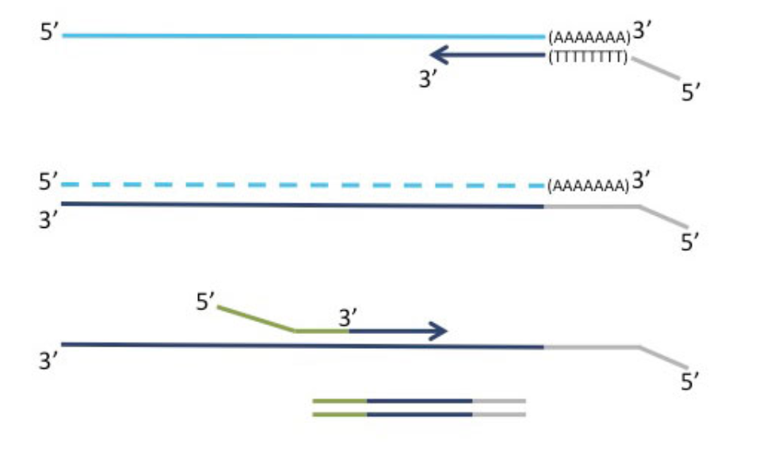
3 prime sequencing
poly-A tail as an adapter-incorporating priming site for 1st strand synthesis
RNA template removal
Stand specific sequencing data is ensured due to the adapter sequence of the primed 2nd strand
Notes:
Only one fragment per transcript is generated, directly linking the number of reads mapping to a gene to its expression.
Library generation is initiated by oligo-dT priming (Fig. 1a), and no prior poly(A) enrichment or ribosomal RNA depletion is required. First-strand synthesis and RNA removal is followed by random-primed synthesis of the complementary strand (second-strand synthesis). Illumina- or IonTorrent-specific linker sequences are introduced by the primers. The resulting double-stranded cDNA is purified with magnetic beads, rendering the protocol compatible with automation

Slide 6
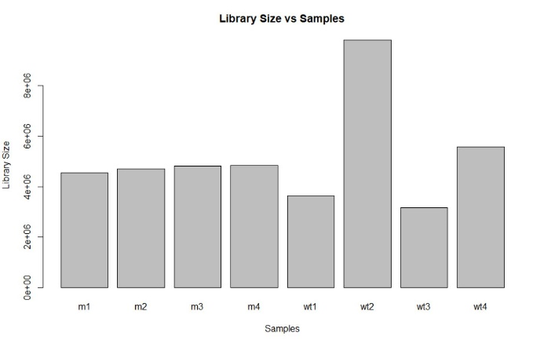
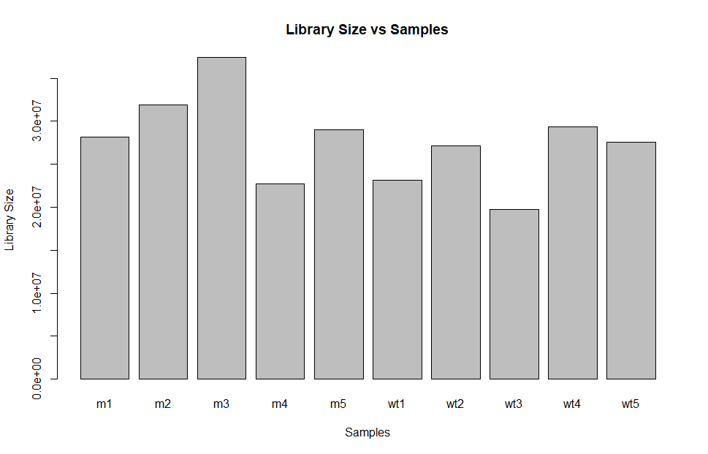
Normalizing for Library Size and Gene Length
56 Day
100 Day
Notes:
Using the edgeR and DESeq packages the samples were 56 and 100 day samples were normalized. Both were normalized for library size and 100 day was normalized for gene length as well using Mouse Genome Informatics

Slide 7
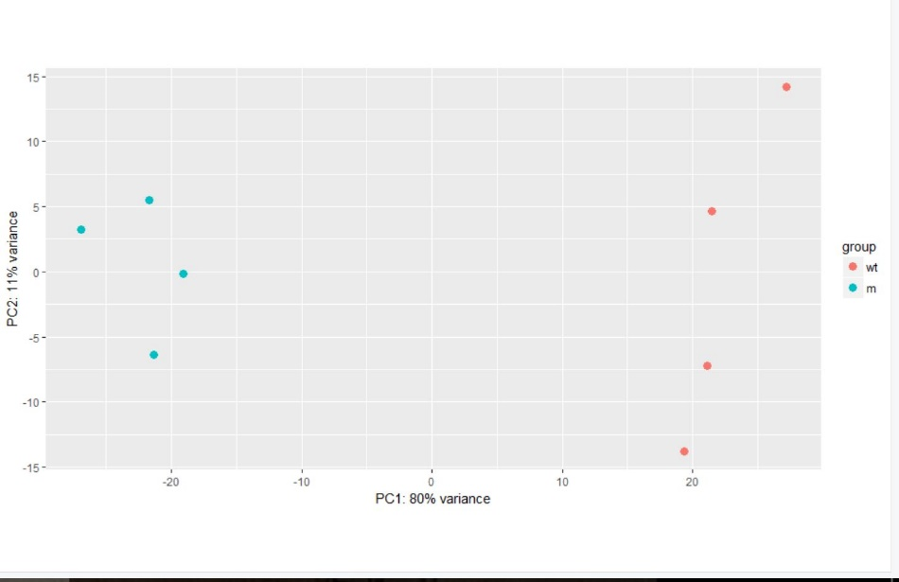
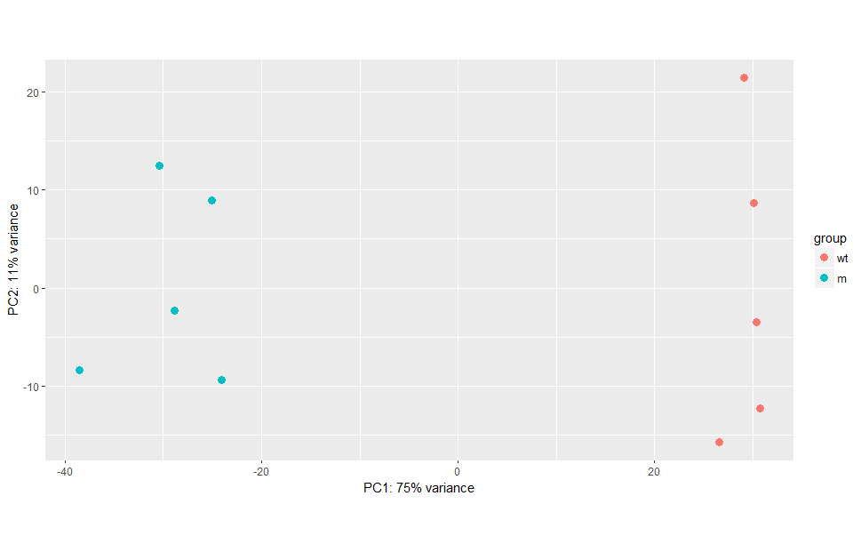
PCA Plots
56 Day
100 Day
Notes:
PCA= principal component analysis. The x-axis represents what the major cause of variation between the samples is. As the mutant and wildtype cluster accordingly to the x-axis means that they are closely related.
The samples were then classified into two categories, wildtype and mutant. This classification is satisfactory as seen in the PCA plot below where wildtype and mutant samples distinctly segregate. Thus meaning there is a distinct difference between the two categories biological and also providing a quality check that the data is correct.

Slide 8
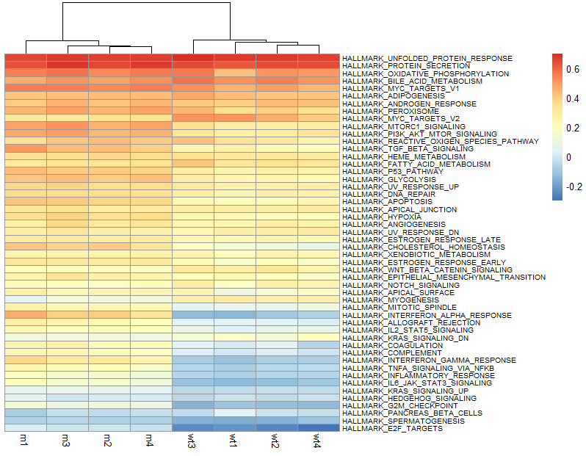
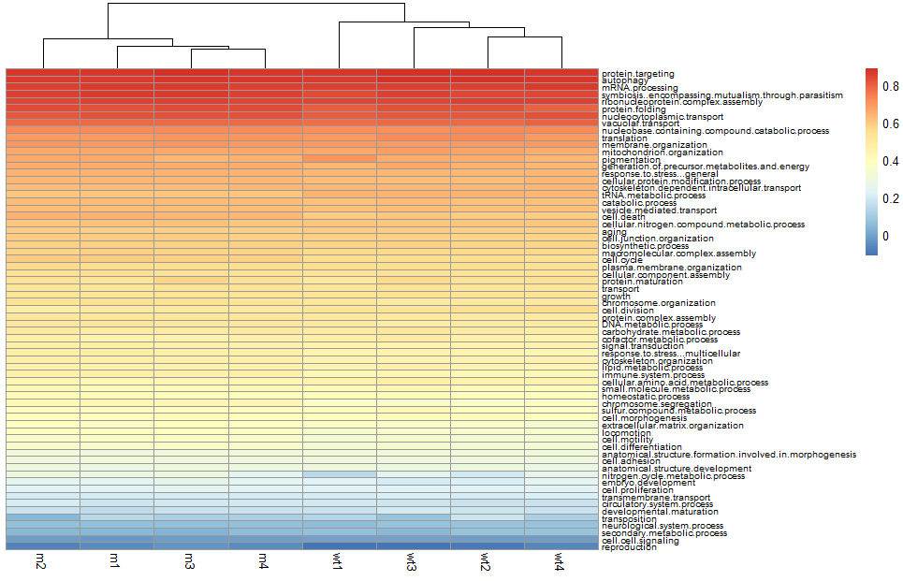
Expression Levels for 56 day samples
Notes:
First the mouse genes were converted to the respective closest human gene. Where duplicate options were available, these genes were removed. This was in order to perform human gene set analysis and later on gene age analysis as all of this is done with human gene information.
These are heat maps of the expression levels of the cancer hallmark gene sets and the GO (gene ontology/biological process) slim gene sets. Red indicating higher level of expression as opposed to blue.
ssGSEA
Single sample GSEA (ssGSEA) calculates a gene set enrichment score per sample as the normalized diﬀerence in empirical cumulative distribution functions of gene expression ranks inside and outside the gene set.

Slide 9
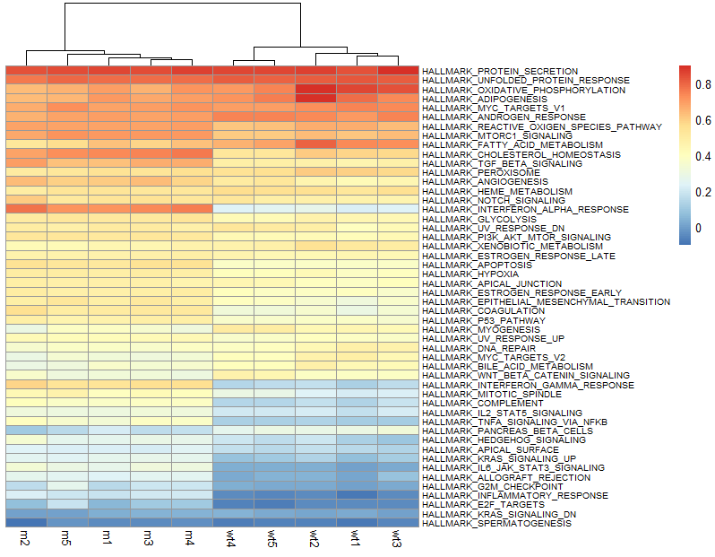
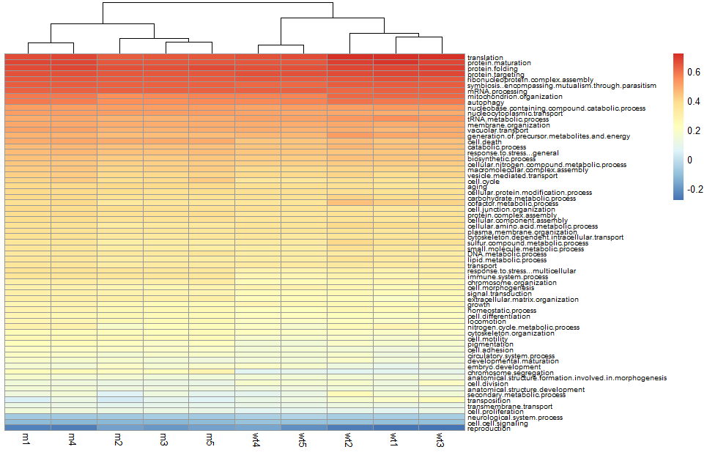
Expression Levels for 100 day samples
Notes:
Please recalculate TAI for all samples, excluding genes in the groups with blue ovals next to them.
Also, exlcude RP23-812C12.3 from TAI calculation, if you haven’t already.
RP23-812C12.3 does not have a human gene equivalent or phylostrata and thus does not affect results.
Exclude the genes related to immune processes as stated by cancer hallmark and Goslim.

Slide 10
Interpretation of the heat maps
Mutant and wildtype samples cluster together
Immune contamination in the sample highly likely
Key hallmark tumour traits are occurring
Cell-cell signalling is under expressed which suggests the cancer cells are becoming more independent from one another
Notes:
Additionally Wilcoxon ranked test was performed to determine which ones were significantly differentially expressed
Interpretation Cancer Pathways:
It can be seen that mutant and wildtype samples cluster together, thus providing reassurance in the reproducibility of the results.
Interferon alpha and gamma responses, inflammatory response and complement cancer pathways are overexpressed in mutant samples. These cancer pathways are involved in the immune response to against cancer. Thus suggesting that there is immune contamination in the sample. Additionally , apoptosis response is slightly overexpressed suggesting the immune cells are inducing apoptosis on the cancer cells.
Angiogenesis, hypoxia and glycolysis is slightly overexpressed. Suggesting the cancer cells are expending a lot of energy thus require increased levels of glycolysis. However these levels are greater than the influx in oxygen and thus results in hypoxia. In response, the cancer cells release chemical factors to induce angiogenesis to produce blood supply and thus an oxygen supply to the cancer cells.
Interpretation GOslim processes:
Slight overexpression in Cell death and immune system response suggest immune contamination and the potentially a hypoxic environment and high cell density could be leading to increased cell death.
Cell-cell signalling is under expressed which suggests the cancer cells are becoming more independent from one another.
The perplexing thing is that chromosome segregation and cell cycle are overexpressed. Suggesting increased cell proliferation which is also overexpressed. However cell division is under expressed.

Slide 11
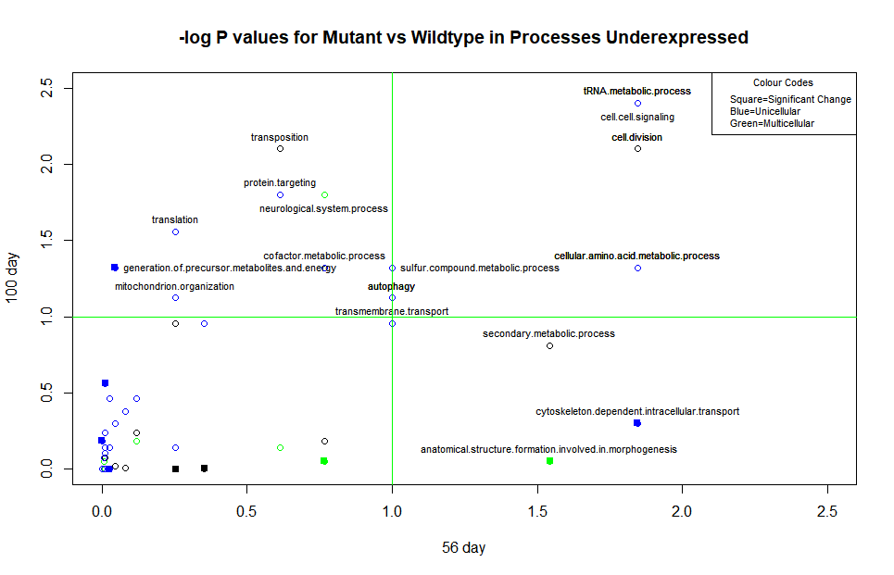
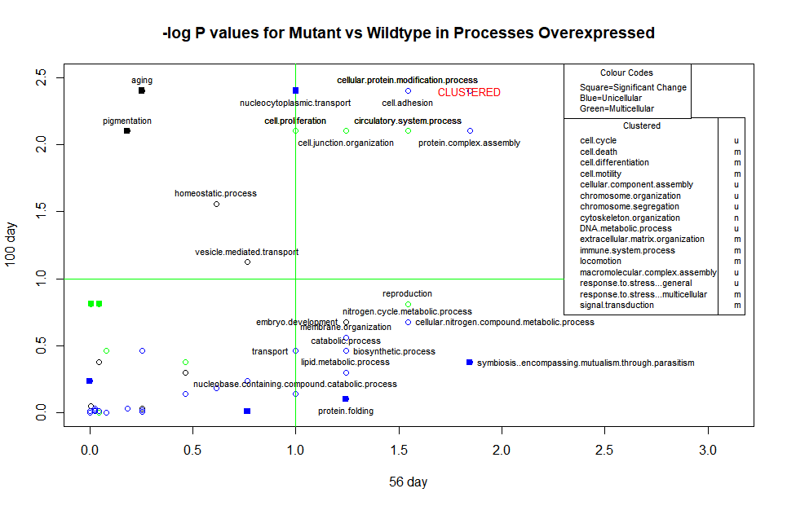
GOslim
Notes:
Comparison between 56 day and 100 day results were done with the following graph. P values were obtained from using the Wilcoxon ranked test on mutant vs wildtype samples for each time point of the ssgsea scores. These values were then transformed by –log10 to result in the low significant p values producing large values. Significant p values is set at 0.1 which is equivalent to the value 1 on the graph which has been highlighted with the green lines. Processes that were significant have their name shown. Colour coding was used to distinguish pathway ages, multicellular (green), unicellular (blue) or neither (black). GOslim biological processes pathways that changed rank by 20 or more between the 56 and 100 day time points are highlighted using a filled square point.

Slide 12
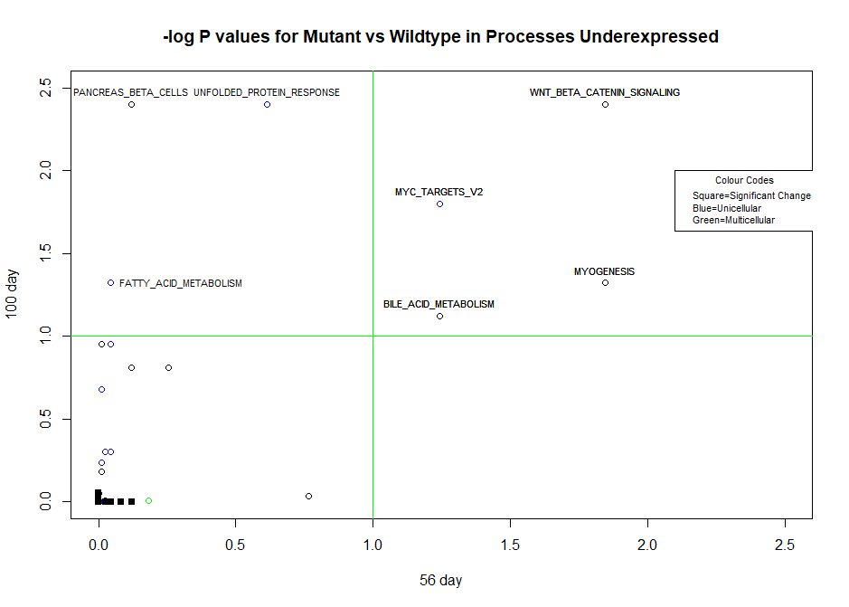
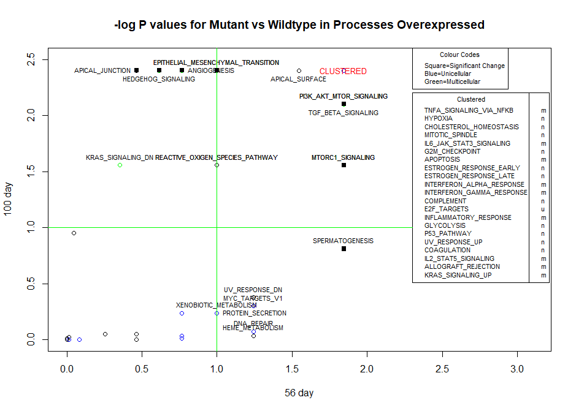
Cancer Hallmark

Slide 13
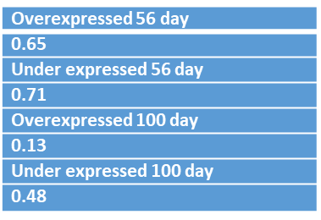
Unicellular vs Multicellular Processes
Although there wasn't significant enrichment, I'd like to see a table of the number of UC/MC genes and processes under/overexpressed and the Fisher p-values.
m u
total
[1] 19 36
> greater56
[1] 13 20
> less56
[1] 2 6
> greater100
[1] 12 10
> less100
[1] 2 9
Number of GOslim processes
Fisher Test
 | Multicellular | Unicellular
Total | 19 | 36
Overexpressed 56 day | 13 | 20
Under expressed 56 day | 2 | 6
Overexpressed 100 day | 12 | 10
Under expressed 100 day | 2 | 9
Overexpressed 56 day
0.65
Under expressed 56 day
0.71
Overexpressed 100 day
0.13
Under expressed 100 day
0.48
Notes:
fisher exact tests were done to analyse if there was a significant number of multicellular or unicellular processes (GOslim) that were being over or under expressed.
Interpretation:
The decrease in p-values from the Firsher test between 56 to 100 day time points suggested there is a larger disparity between unicellular and multicellular processes. With a more significant portion of multicellular processes being overexpressed and unicellular processes being under expressed. Thus suggesting the progression of the cancer through accumulation of mutations and the potential for increase in immune infiltrate.
The number of over expressed genes being greater than under expressed genes suggests that the main driver of the progression of cancer is the overexpression of oncogenes as opposed to the under expression of tumour suppressor genes

Slide 14
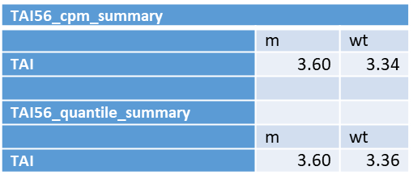
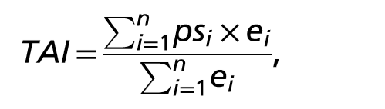
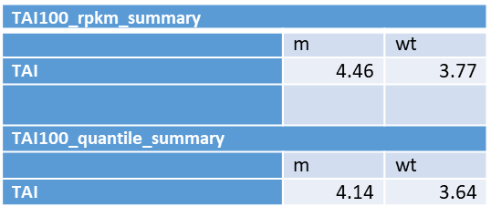
TAI results
TAI56_cpm_summary
 | m | wt
TAI | 3.60 | 3.34
TAI56_quantile_summary
 | m | wt
TAI | 3.60 | 3.36
 | All genes |  | Excl. Immune
 | m | wt | m | wt
TAI56 cpm | 3.60 | 3.34 | 3.59 | 3.37
 | m | wt | m | wt
TAI56 quantile | 3.60 | 3.36 | 3.60 | 3.39
 | m | wt | m | wt
TAI100 rpkm | 4.46 | 3.77 | 4.20 | 3.73
 | m | wt | m | wt
TAI100 quantile | 4.14 | 3.64 | 3.98 | 3.57
TAI100_rpkm_summary
 | m | wt
TAI | 4.46 | 3.77
TAI100_quantile_summary
 | m | wt
TAI | 4.14 | 3.64
Notes:
Differential gene age analysis was then done with the following transcriptome age index (TAI) results
Produced by classifying each gene into a phylostrata from 1-16 with 1-3 representing unicellular processes
M=mutant wt=wildtype
Cpm=Counts per million
Rpkm=Reads Per Kilobase of transcript per Million mapped reads
Quantile=> instead of the above equation, the relative ranks are used instead of expression values
Interpretation:
At the moment the results suggests that the mutant cells have more multicellular genes that are overexpressed than unicellular. Most likely reason is normal and immune contamination which will be further investigated.
a=GOslim_set[["immune.system.process"]]@geneIds
b=msigDB50[["HALLMARK_INTERFERON_ALPHA_RESPONSE"]]@geneIds
c=msigDB50[["HALLMARK_INTERFERON_GAMMA_RESPONSE"]]@geneIds
d=msigDB50[["HALLMARK_IL2_STAT5_SIGNALING"]]@geneIds
e=msigDB50[["HALLMARK_IL6_JAK_STAT3_SIGNALING"]]@geneIds
f=msigDB50[["HALLMARK_ALLOGRAFT_REJECTION"]]@geneIds
g=msigDB50[["HALLMARK_INFLAMMATORY_RESPONSE"]]@geneIds
1801 genes were excluded → around 1254 genes had a phylostrata associated with them
Meaning around 11,000 genes were used as opposed to 12,200 genes (56 day cpm)

Slide 15
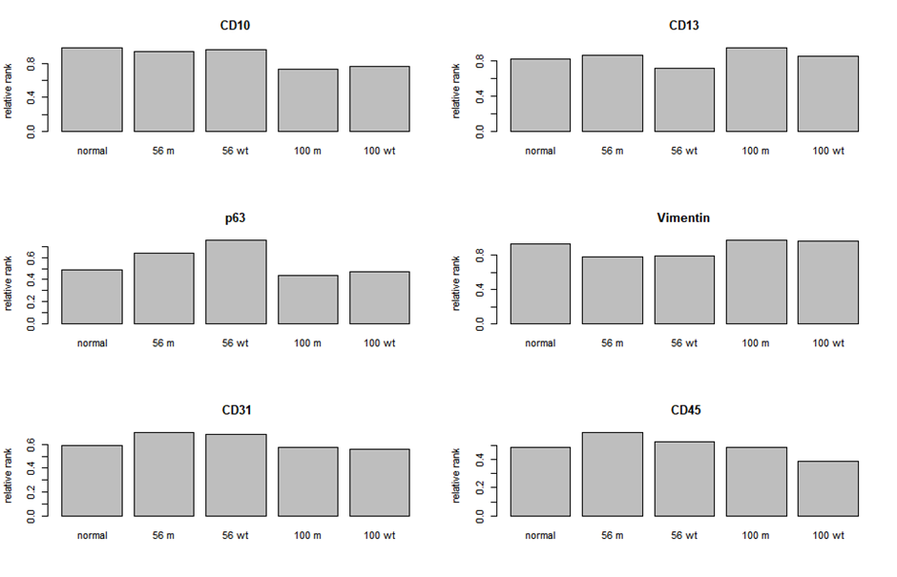
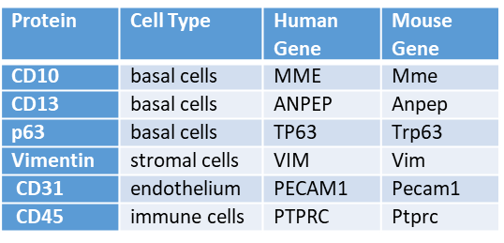
Contamination Normalization
Protein | Cell Type | Human Gene | Mouse Gene
CD10 | basal cells | MME | Mme
CD13 | basal cells | ANPEP | Anpep
p63 | basal cells | TP63 | Trp63
Vimentin | stromal cells | VIM | Vim
CD31 | endothelium | PECAM1 | Pecam1
CD45 | immune cells | PTPRC | Ptprc
Hypothesized to have normal and immune cell contamination
Estimate package was not able to successfully determine purity
6 prostate protein markers
Notes:
The mutant sample has been hypothesized to have normal cell and immune cell contamination and thus the wildtype and normal samples need to be normalized by purity.
Estimate packages was not suitable producing results such as the normal samples being classified as being in the high 90% tumour. Upon reading the paper for estimate it states it does not work on prostate samples due to atypical patterns of tumour-associated cells—that is, increased fractions of normal epithelial cells.
Thus an alternate method was required. Below is a graph of 6 prostate protein markers and their quantile rank in normal prostate expression level standard and in the 56 and 100 day samples. Provided is also a table describing the protein.
Normal reference was normal ventral lobe prostate expression data from an independent study with 5 samples
This was an analysis to see if any of these 6 proteins/genes could be used as prostate markers to indicate the basal cell, stromal cell, endothelium and immune cell components. However the results shown seem to conclude they do not distinguish these cases effectively.

Slide 16
3 prime sequencing effects
> cor(cancer_rank[,1],cancer_rank[,2])
[,1]
[1,] 0.8647173
> cor(cancer_rank[,1],cancer_rank[,3])
[,1]
[1,] 0.7230243
> cor(cancer_rank[,2],cancer_rank[,3])
[,1]
[1,] 0.7349993
> cor(GOslim_rank[,1],GOslim_rank[,2])
[,1]
[1,] 0.653989
> cor(GOslim_rank[,1],GOslim_rank[,3])
[,1]
[1,] 0.3453293
> cor(GOslim_rank[,2],GOslim_rank[,3])
[,1]
[1,] 0.5363651
mean(abs(cancer_rank[,1]-cancer_rank[,2]))
[1] 2.32
> mean(abs(cancer_rank[,1]-cancer_rank[,3]))
[1] 2.04
> mean(abs(cancer_rank[,2]-cancer_rank[,3]))
[1] 2.84
>
> mean(abs(GOslim_rank[,1]-GOslim_rank[,2]))
[1] 2.119403
> mean(abs(GOslim_rank[,1]-GOslim_rank[,3]))
[1] 3.164179
> mean(abs(GOslim_rank[,2]-GOslim_rank[,3]))
[1] 2.865672
 | Correlation for cancer hallmarks
56 3’ m vs 100 m | 0.86
56 3’ m vs 100 3’ m | 0.98
100 m vs 100 3’ m | 0.85
56 3’ wt vs 100 wt | 0.89
56 3’ wt vs 100 3’ wt | 0.95
100 wt vs 100 3’ wt | 0.92
 | Correlation for GOslim
56 3’ m vs 100 m | 0.90
56 3’ m vs 100 3’ m | 0.98
100 m vs 100 3’ m | 0.91
56 3’ wt vs 100 wt | 0.89
56 3’ wt vs 100 3’ wt | 0.93
100 wt vs 100 3’ wt | 0.94
 | 56 3’ m | 56 3’ wt | 100 m | 100 wt | 100 3’ m | 100 3’ wt
TAI cpm/rpkm | 3.60 | 3.34 | 4.46 | 3.77 | 3.65 | 3.35
TAI quantile | 3.60 | 3.36 | 4.14 | 3.64 | 3.66 | 3.32
Notes:
It can be seen in these results that the 100 3’ data is more closely related to the 56 3’ data than the 100 day normal sequenced data. Thus suggesting sequencing method skews results and will need to be normalized for in the future.
CORRELATION OF WHAT? MEAN ssGSEA SCORES?
mean ssGSEA scores for wildtype and tumour were taken and used to rank the gene sets from most to least expressed. These rankings were then used to determine the correlation between the sets of samples

Slide 17
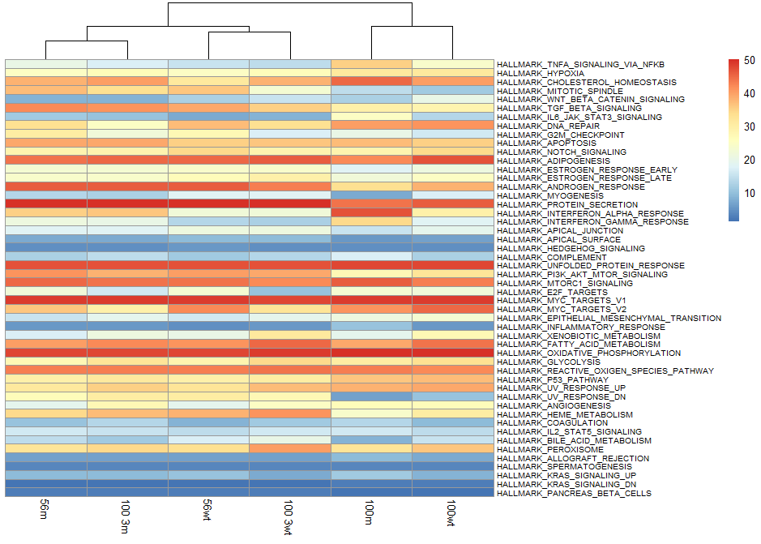
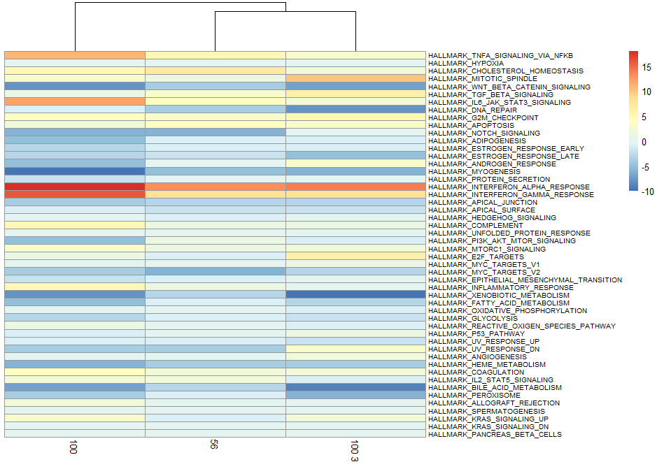

Slide 18
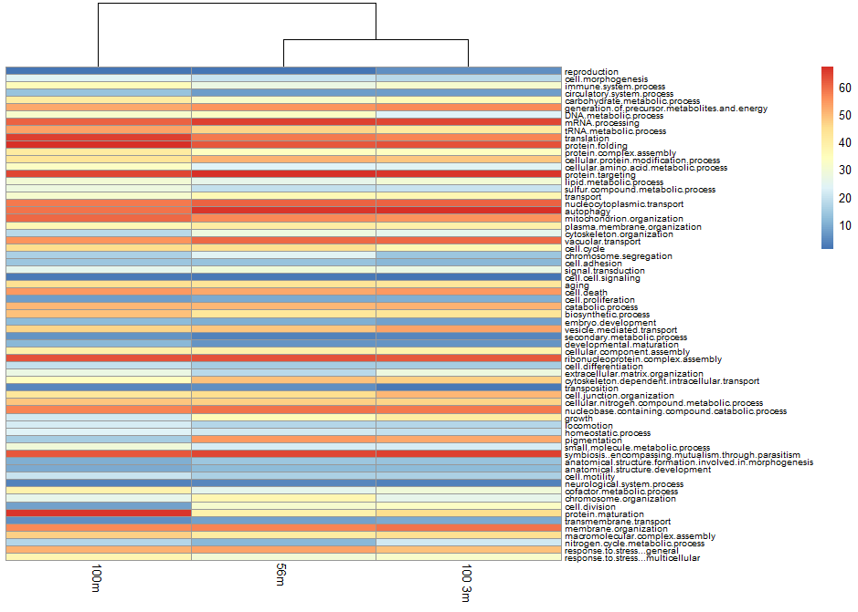
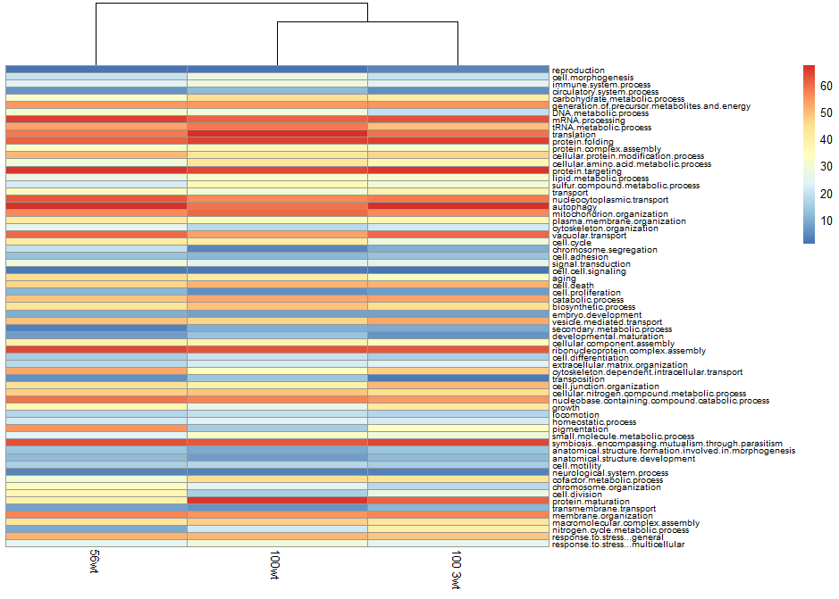
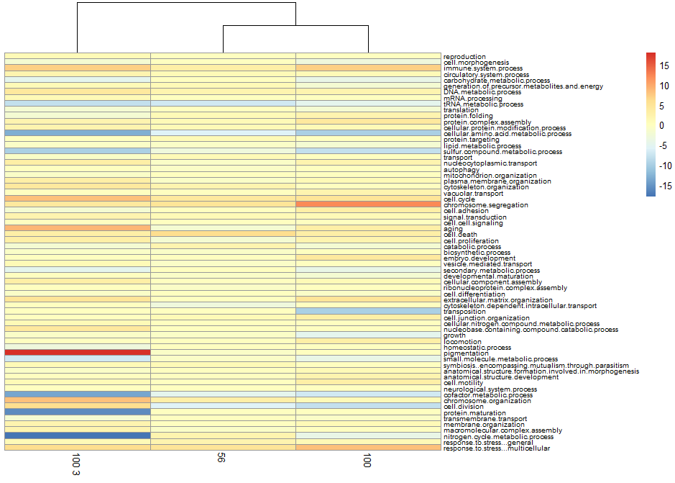

Slide 19
Artefact in 3 prime sequenced data
In the HTSeq results a large percentage of genes were mapping to RP23-81C12.3 (lincRNA gene) in each sample
56 day 3 primed sequenced (Peter Mac pipeline)
56 day 3 primed sequenced (Bluebee pipeline)
100 day fully sequenced
m1 | m2 | m3 | m4 | wt1 | wt2 | wt3 | wt4
21% | 20% | 20% | 20% | 26% | 10% | 30% | 17%
m1 | m2 | m3 | m4 | wt1 | wt2 | wt3 | wt4
13% | 18% | 16% | 9% | 23% | 15% | 14% | 16%
m1 | m2 | m3 | m4 | m5 | wt1 | wt2 | wt3 | wt4 | wt5
0.07% | 0.06% | 0.05% | 0.08% | 0.07% | 0.08% | 0.07% | 0.10% | 0.06% | 0.07%
Notes:
lincRNA= Long intergenic noncoding RNAs
It has been hypothesized that this artefact and using differing methods of 3 prime and full RNA sequencing have affected results.. Thus the analysis of this artefact was performed.

Slide 20
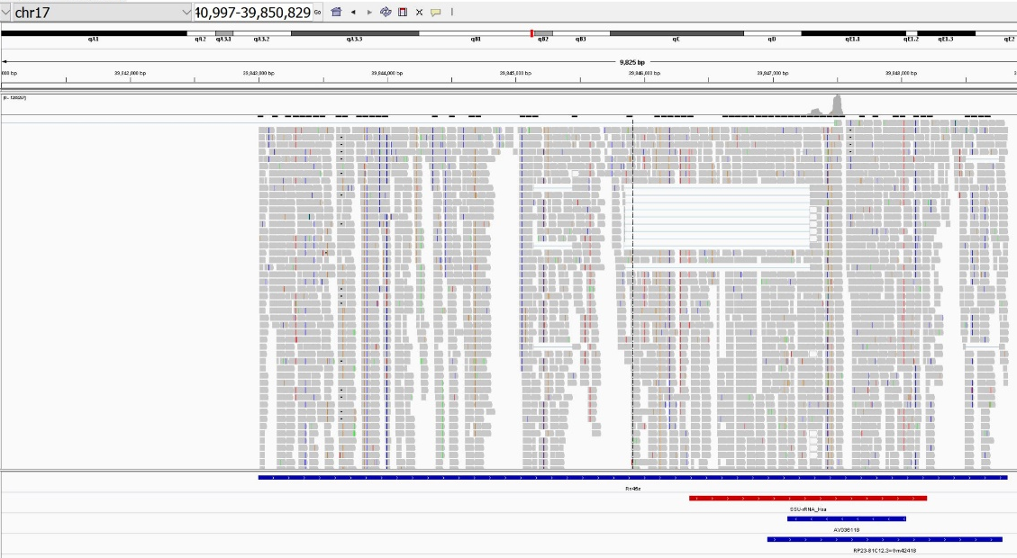
All the reads tend to map to this 54bp section
Mapping quality high
Multiple hits is low and next best alignment is poor
Rn45s, 45S pre-ribosomal RNA
SSU-rRNA_Hsa, RepeatMasker
AY036118, lincRNA gene
RP23-81C12.3=Gm42418, lincRNA
Notes:
All the reads tend to map to this 54bp section Chr17 with between 9-23% irrelevant of being a wildtype, mutant or time point
Mapping quality to this area is 59.9 which is high in comparison to the rest of the genome mapping quality of 50. (Highest possible mapping quality is 60)
Multiple hits is low in this area with an average of effectively 1 hit and the next best hit having an alignment score of -5. This is better than with the 80 top expressed genes in normal prostate which have on average 2.2 hits and the next best hit having an alignment score of -2.1.
All the reads tended to map to a 54bp section of chromosome 17. One pre-ribosomal RNA and two lincRNA are encoded in this section of chromosome. Originally it was hypothesized that this was occurring due to poor mapping quality or multiple possible alignments to the reads, however it was found that these large number of reads mapping to this section have abnormally high mapping quality, low multiple hit scores and the next best possible alignments are poor. Thus potentially suggesting a flaw in the 3 prime sequencing picking up on other RNA types instead of the desired mRNA which reflects the transcriptome.
Additionally in this area is a known repeat sequence SSU-rRNA Has and the 54bp sequence also compatible to mapping to 3 other locations in the mouse genome that are not a part of the transcriptome. Thus further suggesting that there is potentially a large amount of other RNA sources besides mRNA being transcribed that contain this 54bp sequence.
SSU-rRNA small subunit ribosomal RNA

Slide 21
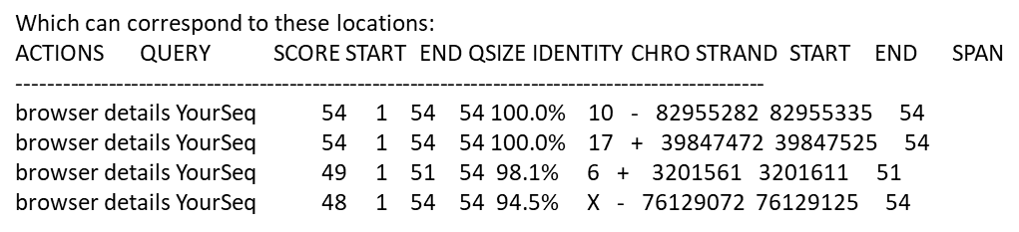
Locations of similar sequences
Notes:
4 areas of SSU rRNA repeat

Slide 22
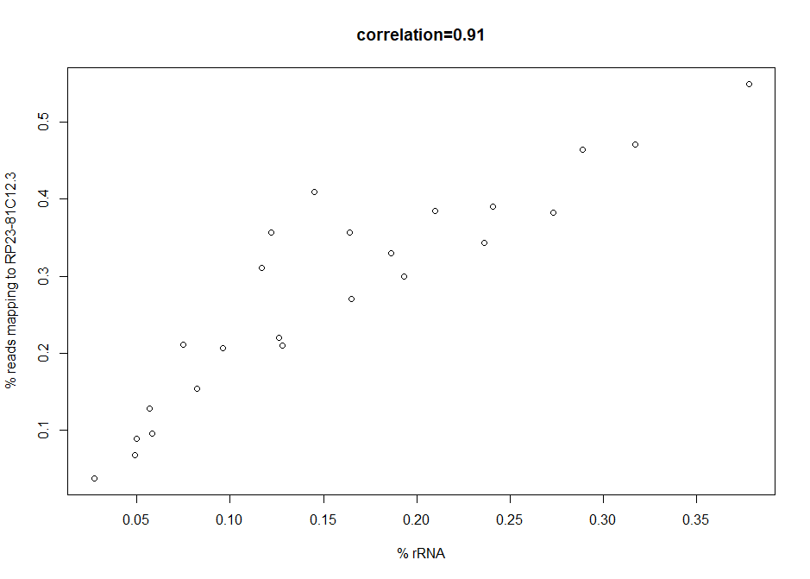
Notes:
The plot above shows a high correlation between increasing rRNA rate and the increase in reads mapping to RP23-81C1.3. Thus suggesting that RNA sequencing is obtaining rRNA sources instead of solely mRNA sources.

Slide 23
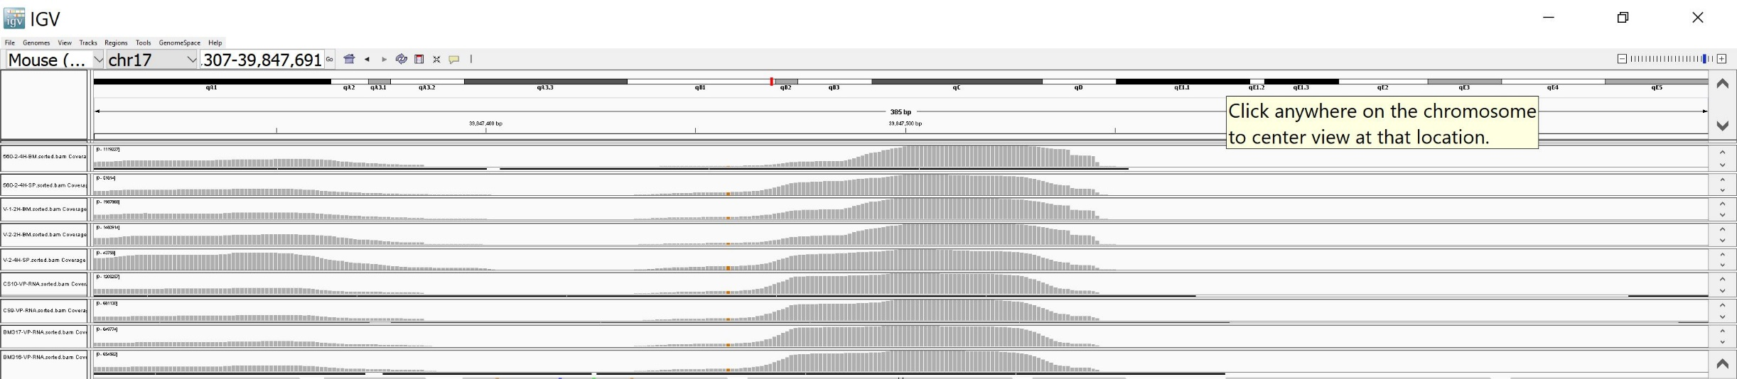
No. Reads at peak | rRNA rate
1.1 million | 0.289
50 thousand | 0.057
1.9 million | 0.378
1.5 million | 0.317
41 thousand | 0.027

Slide 24
Correlation networks
Ethan Grooby Summer Student
Supervisor: : Anna Trigos PHD student

Slide 25
Background
Aim: To determine the reproducibility of gene networks
For different tumours, samples have been taken from individuals and gene expression levels have been determined. These have then been used to determine the relationship between genes if one activates, inhibits or has no relationship with the other. Overall this data has been transformed into gene network modules which are sets of genes that are highly correlated with each other.

Slide 26
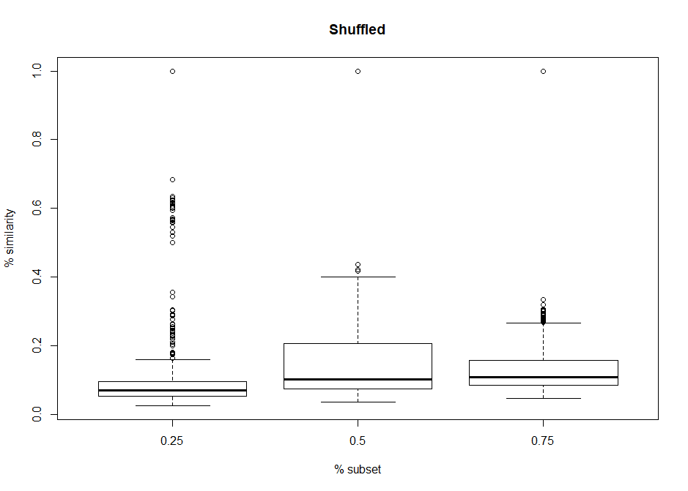
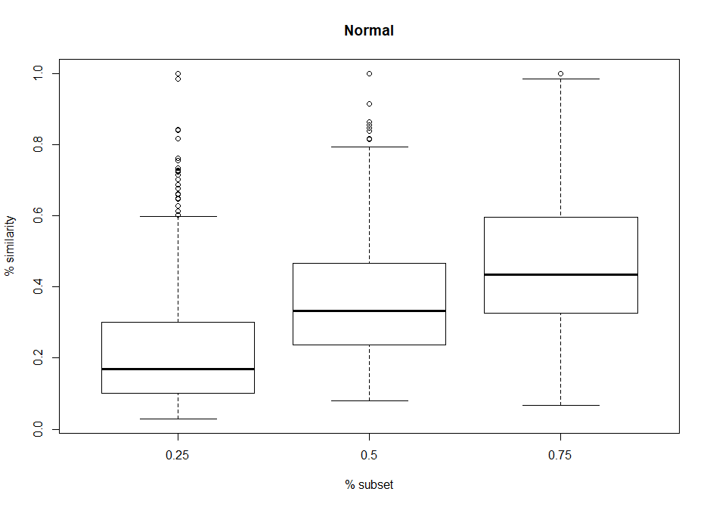
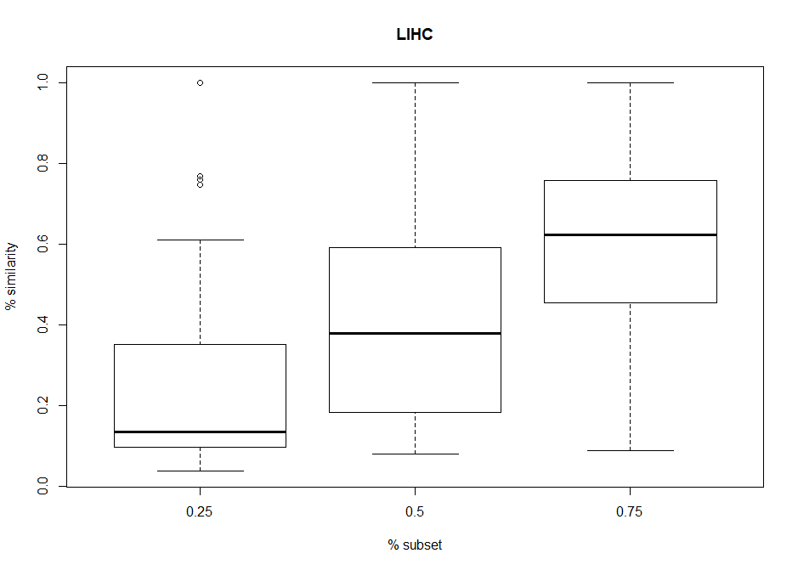
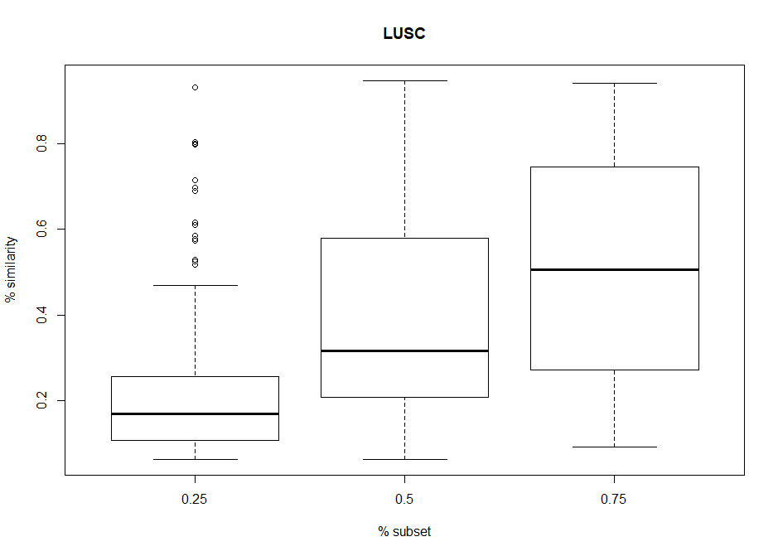
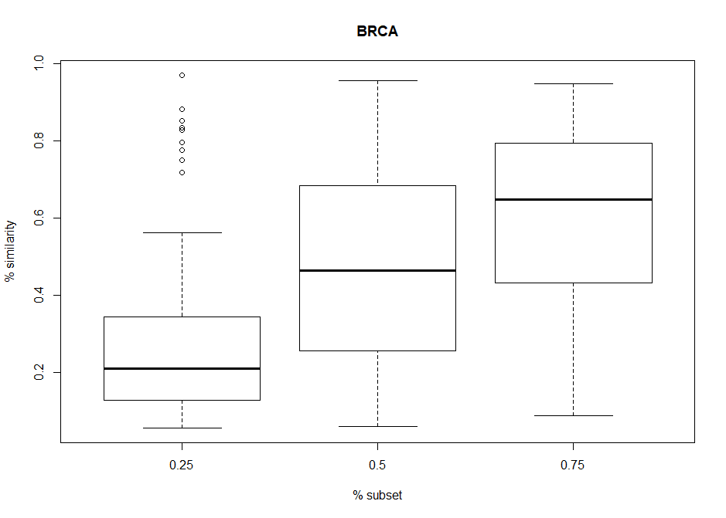
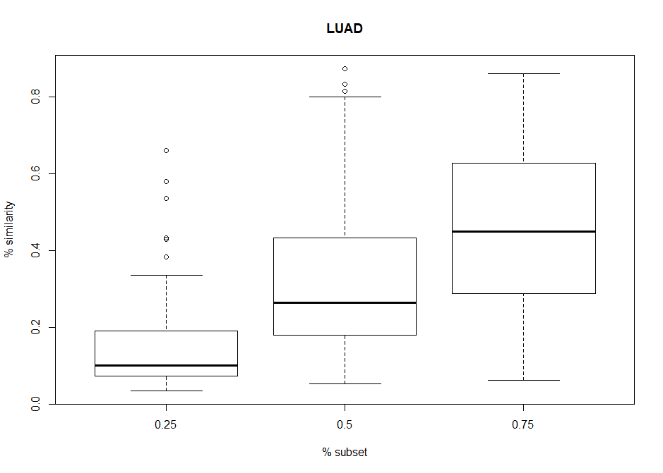
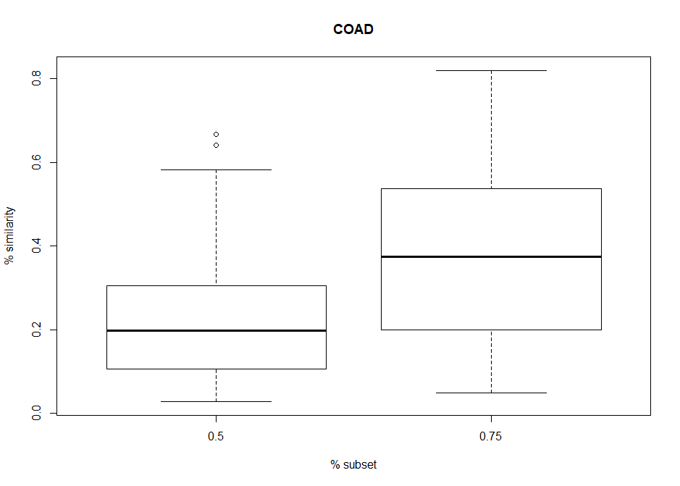
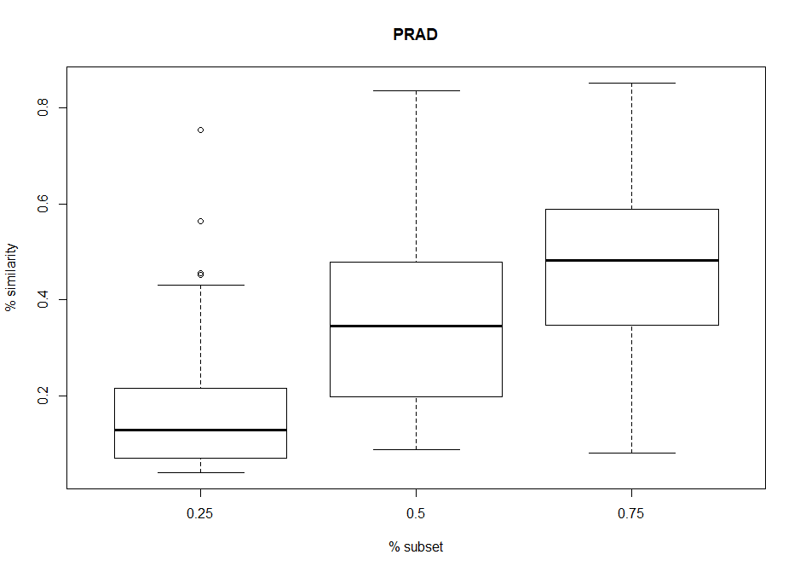
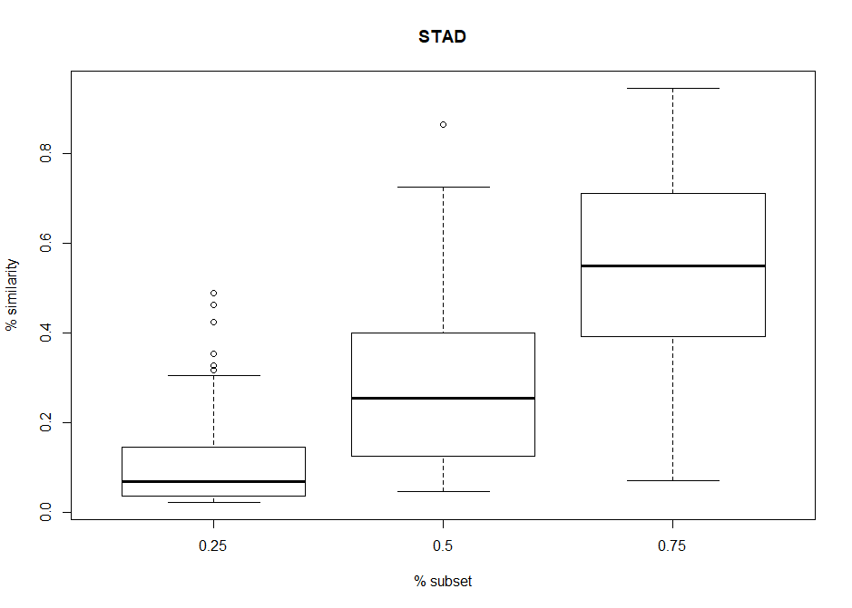
Results
Notes:
Above are two graphs displaying the distribution of percentage similarity between the original module set and the best match module produced from a particular x% subset of individuals taken from the original module. The left graph has been generated with the subset gene names shuffled, thus providing a benchmark of what non-similar best match module results look like. Whereas the graph on the right displays the results of 42 simulated run throughs on selecting a random subset of individuals to produce gene network modules. As expected, increasing the subset percentage of individuals in the normal graph produces an increased percentage similarity. It can also be seen that a 25% subset of data can still produce some useful information about gene networks with the percentage similarity being above what a random shuffled distribution has produced.

